Slide 1

Warby Parker Case
Learn SQL from Scratch | Funnels
Frederico Meneses
23/06/2018

Slide 2
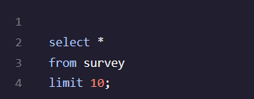
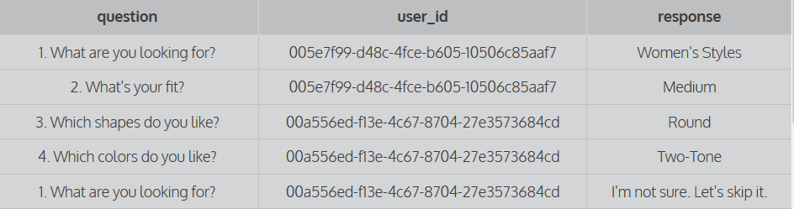
WP Case - Exercise 1
This query gives us the following:
A table containing WP Quiz’s results
The * means that we have selected all columns available
Columns: Question, user_id and response (see below)
All this information was obtained from the quiz table called survey
We limited our results to the first 10 rows/results

Slide 3
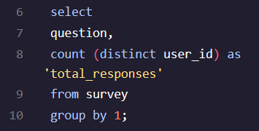
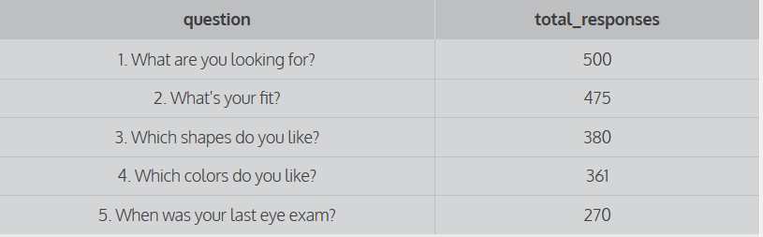
WP Case - Exercise 2
This query gives us the following:
The total amount of responses per question
Columns selected: Question and ‘Total_responses’
Count (distinct user_id) – we have used this function in order to count all unique users that have replied to the quiz
All this information was obtained from the quiz table called survey
When using the function group by 1, we are grouping all unique users by question in order to understand how many unique users have replied to each question

Slide 4
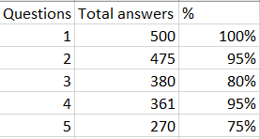
WP Case - Exercise 3
Q3 - ”Which shapes do you like”?
Why:
It requires more information next to the 3 options, similarly, to what we have in the question 2 for example, giving more examples to the customer helping me in the decision process
it might be quite difficult to know which shapes could fit better without trying first
Q5 - ”When was your last exam”?
Why:
Think most people usually do not remember when was their last eye exam
We might have a high level of friction as the customers needs to do an extra effort to remember the above + the Q5 is the 6th question whereas customer’s patience/attention span is lower. ( could be interesting to a/b test this question as if it was a Q2 or Q3 question and see if there is any significant change
% = number of total answers of the current question/number of total answers of the previous question. Example: Only 75% of the total respondents have replied to the 5th question
The 2 questions with lower completion rate are the questions number 3 (80%) and 5 (75%)
The proposed causes, in the grey box

Slide 5

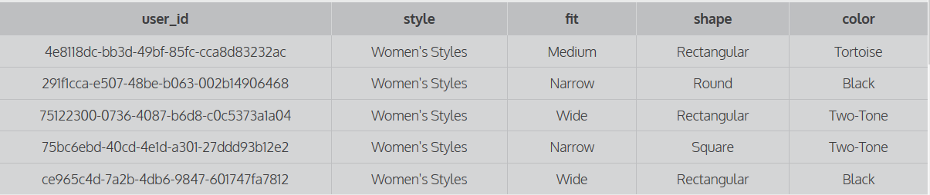
WP Case - Exercise 4 – Table Quiz
This query gives us the following:
A table containing WP Quiz’s results
The * means that we have selected all columns
Columns: user_id, style, fit, shape and color (see below)
All this information was obtained from the quiz table
We limited our results to the first 5 rows/results

Slide 6

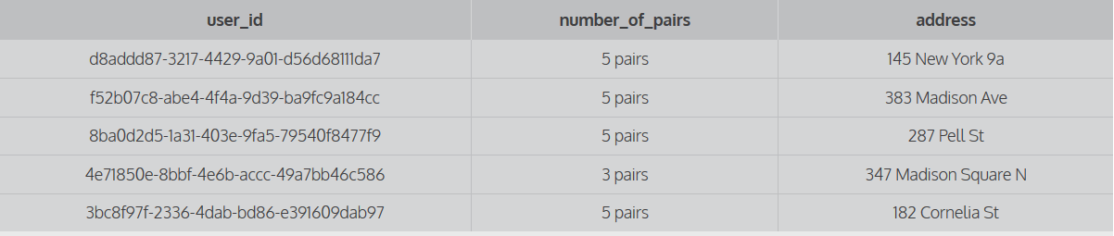
WP Case - Exercise 4 – Table Home_try_on
This query gives us the following:
A table containing WP Quiz’s results
The * means that we have selected all columns
Columns: user_id, number_of_pairs and address(see below)
All this information was obtained from the home_try_on table
We limited our results to the first 5 rows/results

Slide 7

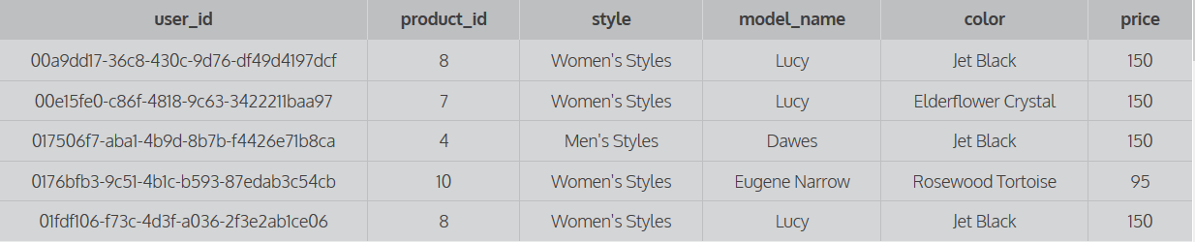
WP Case - Exercise 4 – Table Purchase
This query gives us the following:
A table containing WP Quiz’s results
The * means that we have selected all columns
Columns: user_id, product_id, style, model_name, color and price (see below)
All this information was obtained from the purchase table
We limited our results to the first 5 rows/results

Slide 8
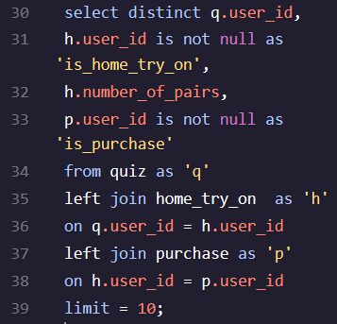
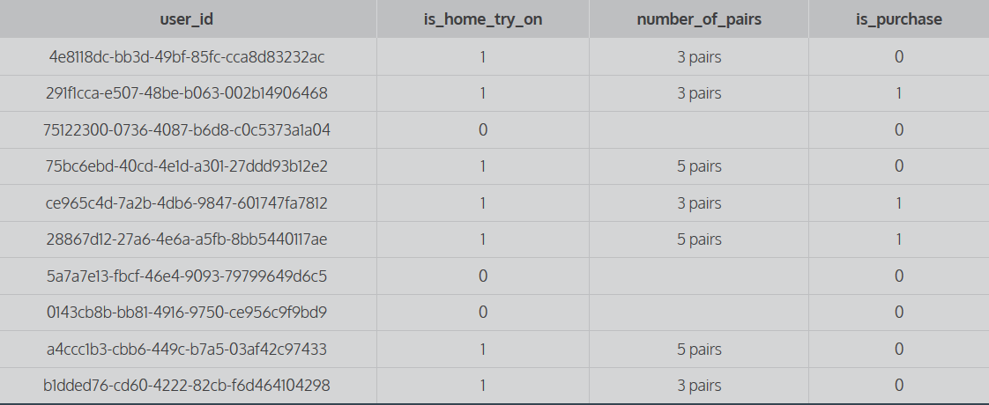
WP Case - Exercise 5
This query gives us the following:
A table containing WP Quiz’s results
Columns selected: q.user_id, h.user_id, h.number_of_pairs and p.user_id
“is not null” means that we only consider the variable’s result if the variable has results or have entries
All this information was obtained due to the function left join combining 3 different tables: quiz , home_try_on and purchase
The common element among all of the tables is user_id
We limited our results to the first 10 rows/results

Slide 9
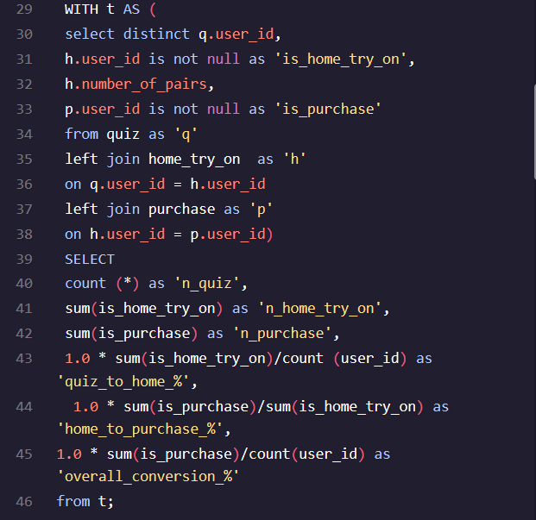

WP Case - Exercise 6 | Part 1
This query gives us the following:
Overall Conversion % : 0.495
Cvr% from Quiz – Home_try_on: 0.75
Cvr% from Home_try_on – Purchase: 0.66
1000 people have done the Quiz
750 went from the Quiz to the Home_try_on
495 went from the Home_try_on to the purchase stage

Slide 10
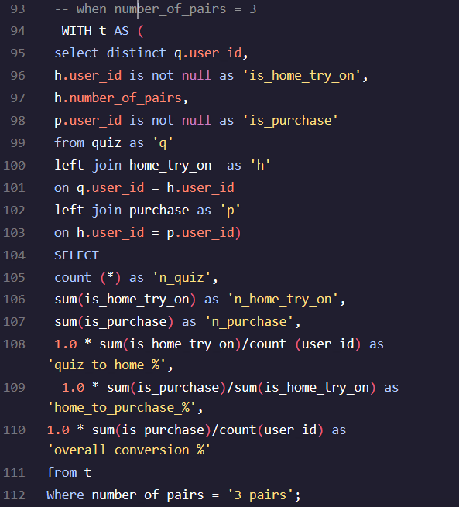
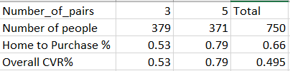
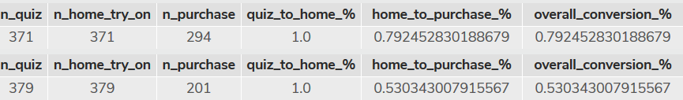
WP Case - Exercise 6 | Part 2
This query gives us the following cvr% per funnel accordingly to the number of pairs that the customer has chosen .
Interesting facts:
When the customer gets 5 pairs, the cvr% increases +61% (( 0.79-0.49)/(0.49)
When the customer gets 3 pairs , the cvr% increases +8.16% (( 0.53-0.49)/(0.49))
*In order to get the same results regarding 5 pairs, swipe the number 3 for the number 5 in these 2 lines: number_of_pairs = 3 and where number_of_pairs = ‘3 pairs’

Slide 11
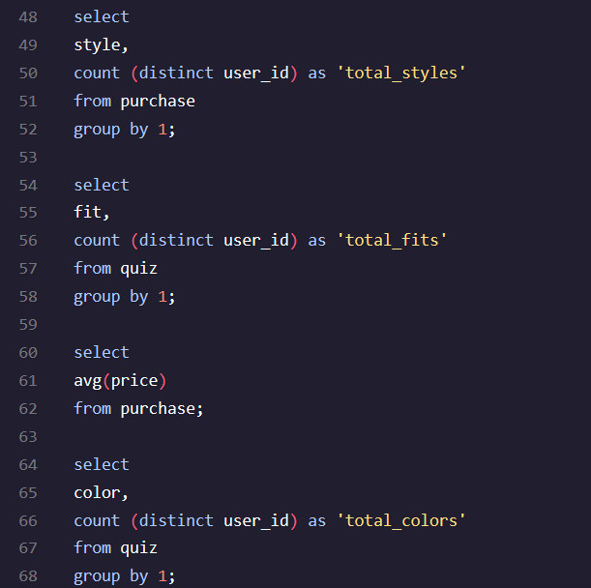

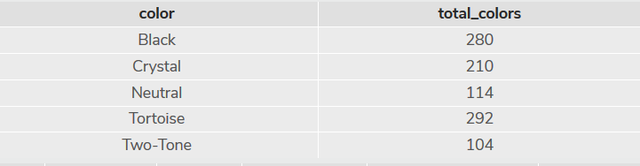
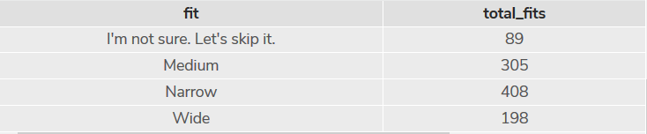
WP Case - Exercise 6 | Part 3
This query gives us the following:
Gender %:
F: 252/500 = 50.4%
M: 248/500 = 49.6%
Fit %:
Medium: 305/1000 = 30.5%
Narrow: 305/1000 = 40.8%
Wide : 305/1000 = 19.8%
AOV € : 112.7€
Favourite colors:
Black: 280/1000 = 28%
Crystal: 210/1000 = 21%
Neutral: 114/1000 = 11.4%
Tortoise: 292/1000 = 29.2%
Two’Tone: 104/1000 = 10.4%

Slide 12
WP Case - Exercise 6 | Conclusions
Conclusions:
Typical Customer:
- Gender: Female/Male
- Style: Narrow
- AOV: 112.7€
- Favourite Color: Black and Tortoise
In order to increase the number of people answering the question 3 and 5 more often you should a/b test the position of the questions and see if the order has impact. For example, maybe put the questions that require more effort( for example the question number 5), in the middle rather than in the end of the quiz in order to reduce friction
In order to increase overall cvr%:
All your comunication strategy should reiforce and/or give exposure to the features of the typical customer
Add an incentive to Increase the number of customers trying 5 pairs instead of only 3
Find the marginal add of number of pairs in order to maximize cvr%
Use social proof regarding the style and favourite colours : “Everyone has been picking the style Narrow and in black and Tortoise in order to increase cvr%
Free delivery and/or any other bonus if you spend above 112.99€ resulting in AOV increase

